Slide 1



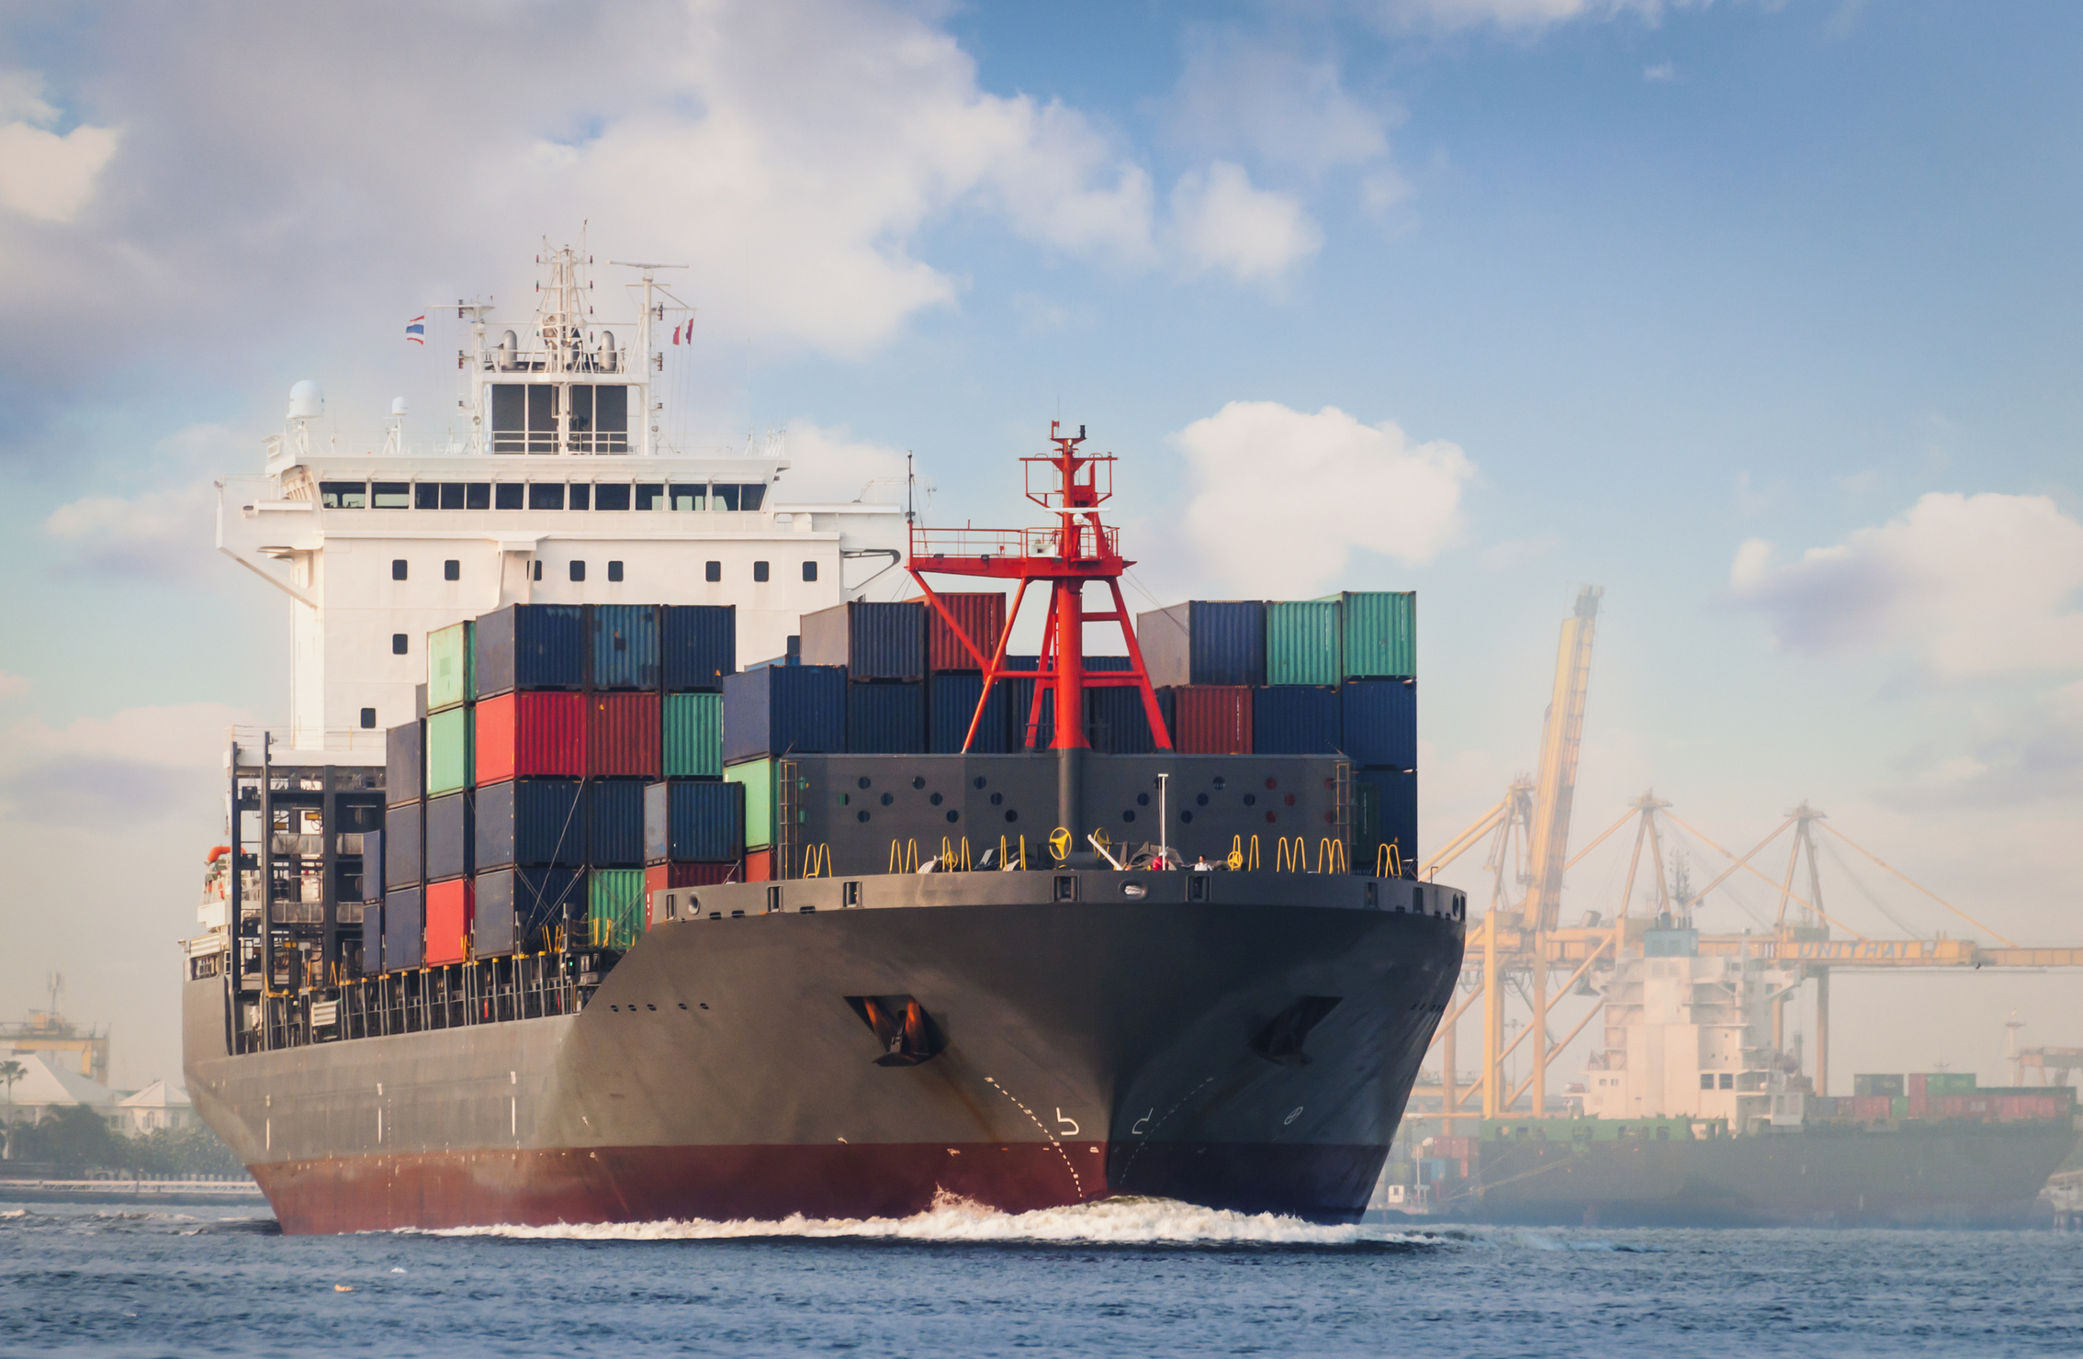

Olist Shipping Company Evaluation
By: Narrow Insights Analytics

Slide 2



Introduction

Slide 3
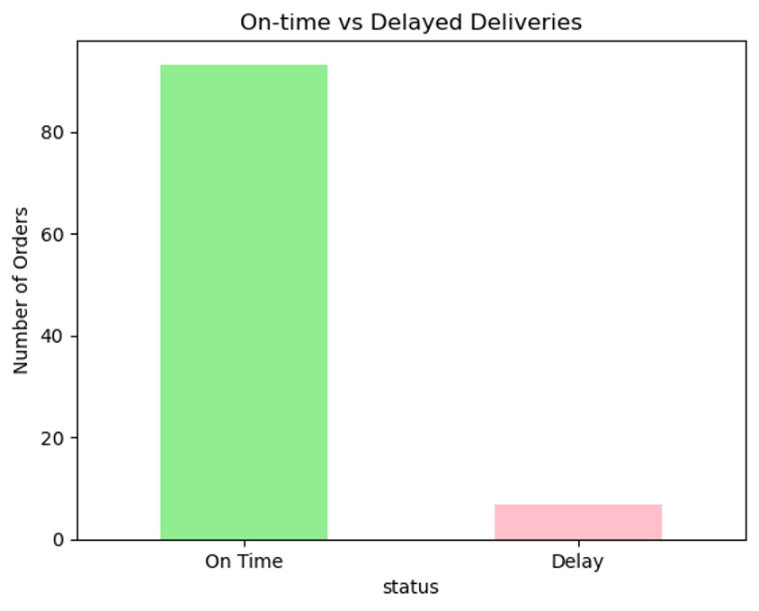
How well is Olist’s shipping partner performing in terms of timeliness?

Slide 4
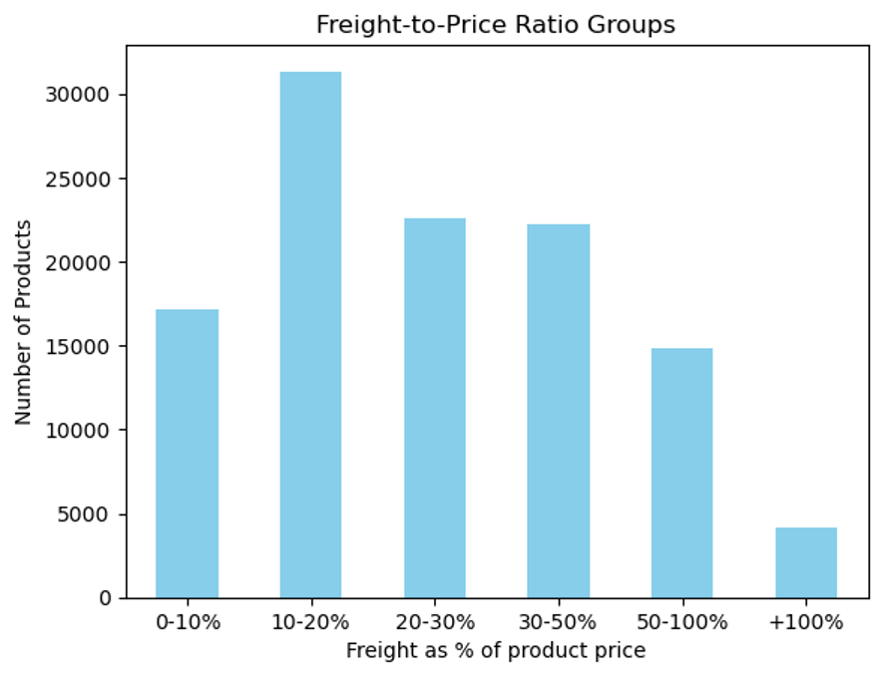
How well is Olist’s shipping partner performing in terms of cost?

Slide 5
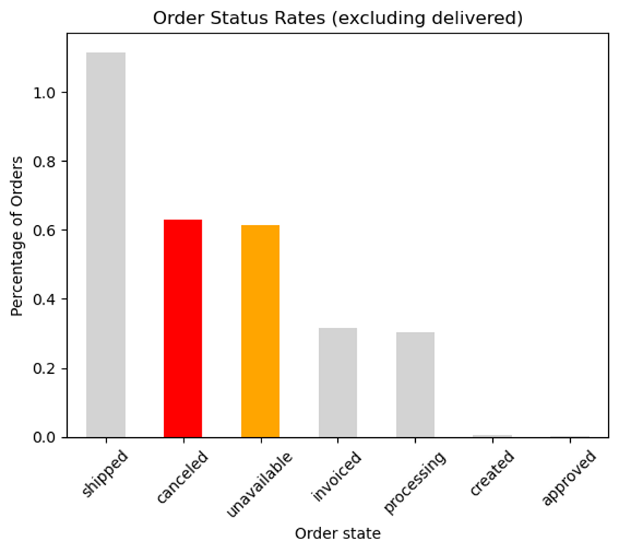
How well is Olist’s shipping partner performing in terms of reliability?

Slide 6
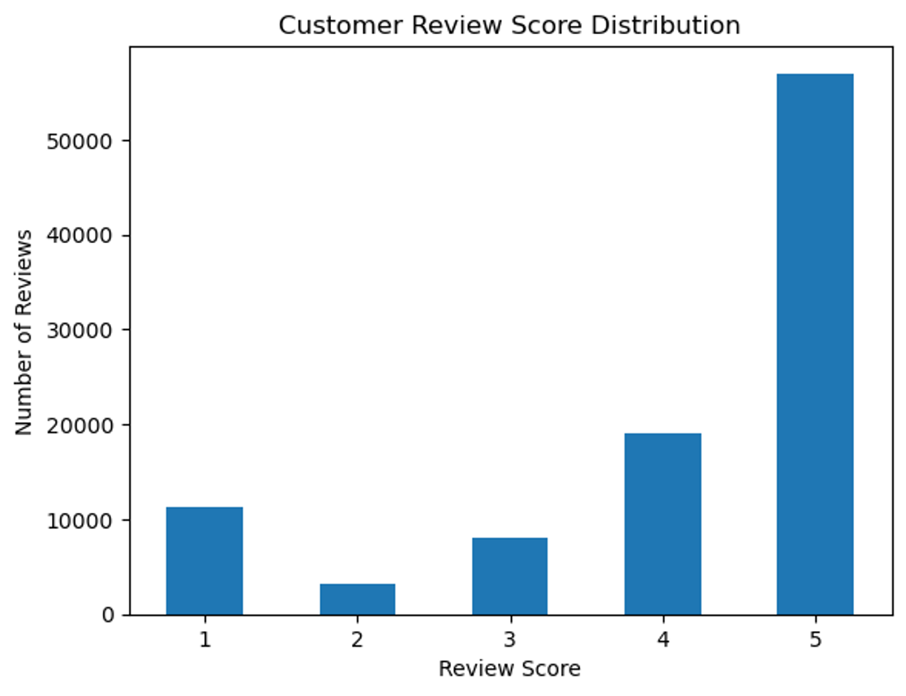
How well is Olist’s shipping partner performing in terms of service quality?

Slide 7
What are the key metrics for evaluating performance on-time delivery rate, delay percentage, freight-to-product ratio, customer satisfaction?
On time
delivery rate:
93.22%
Delay rate:
6.78%
Customer
satisfaction:
4.09/5
Fright to
price ratio:
32%

Slide 8
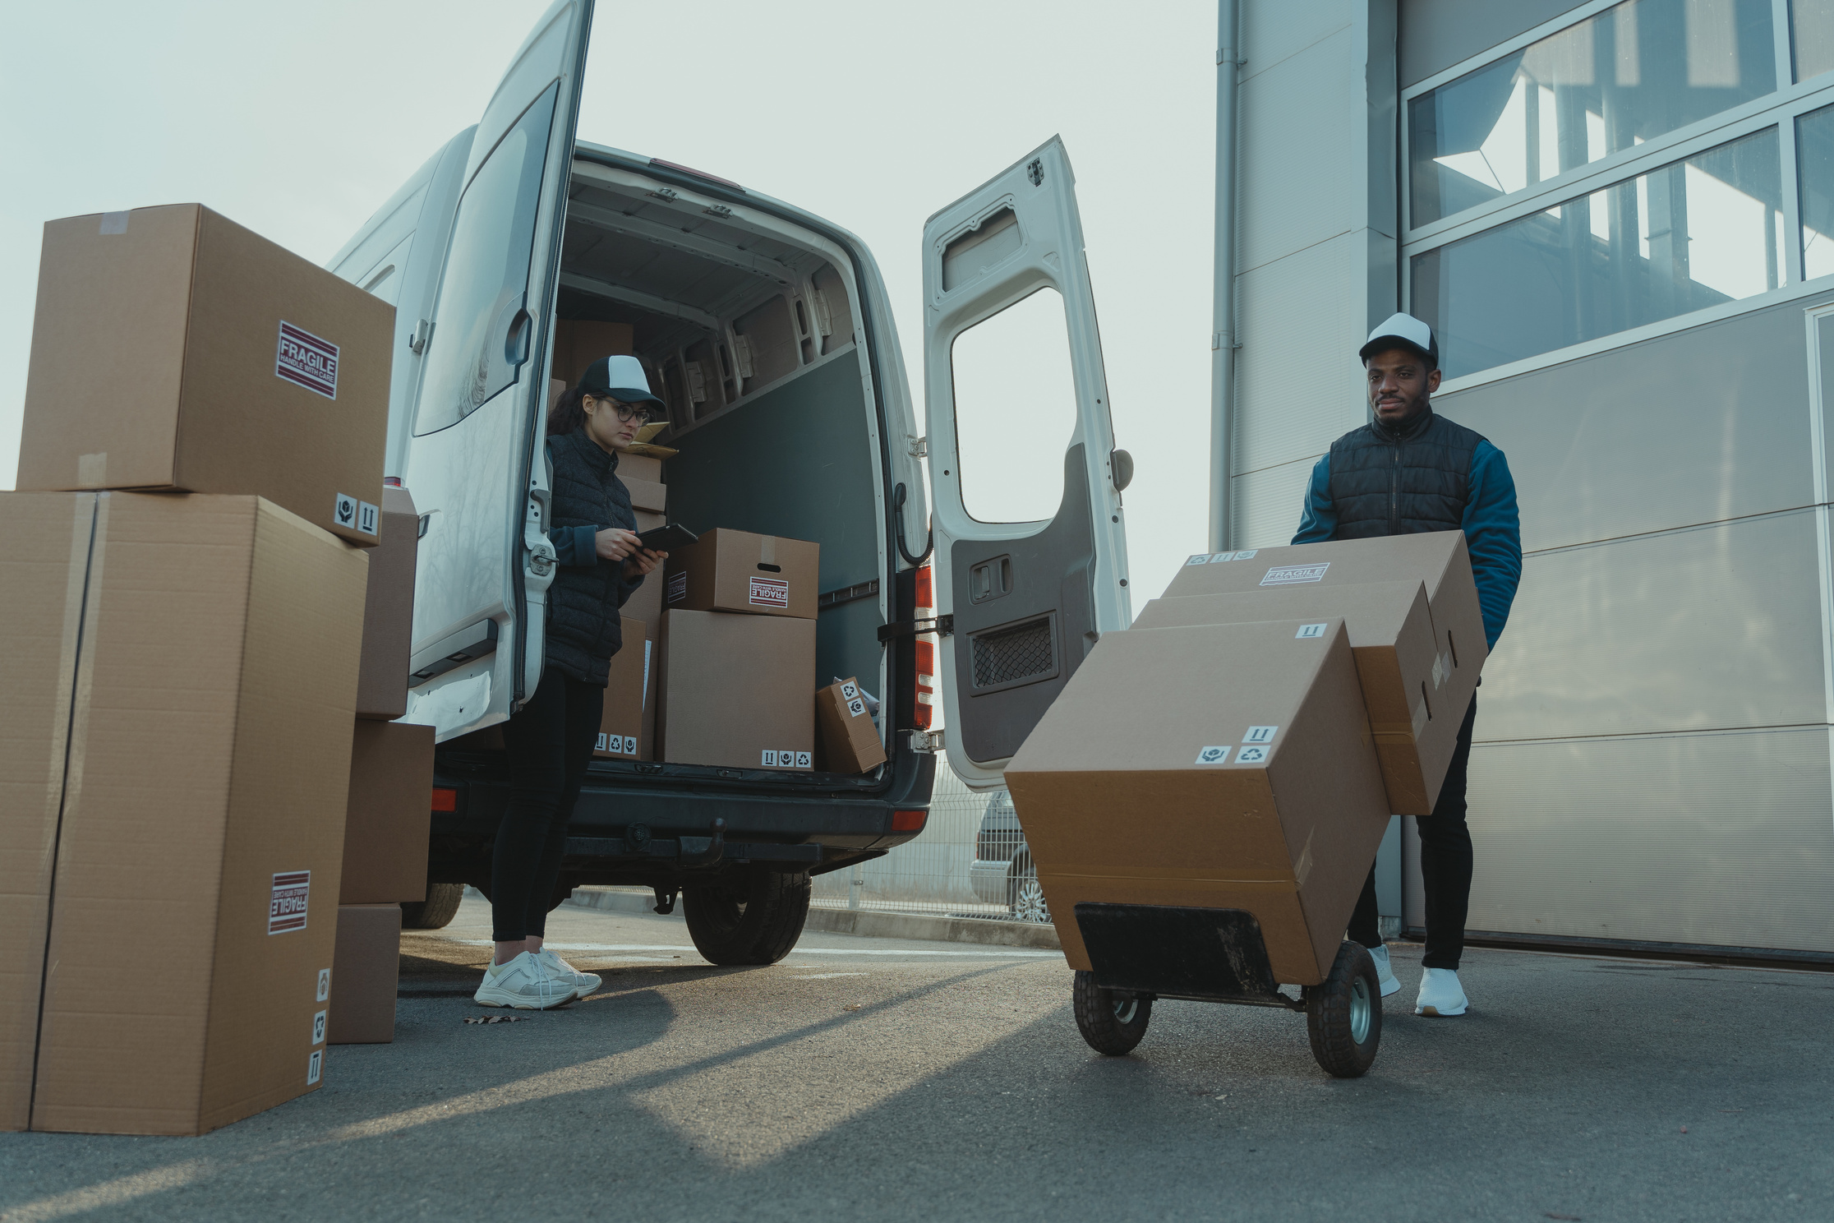

What percentage of orders are delivered late?
6.7 %

Slide 9
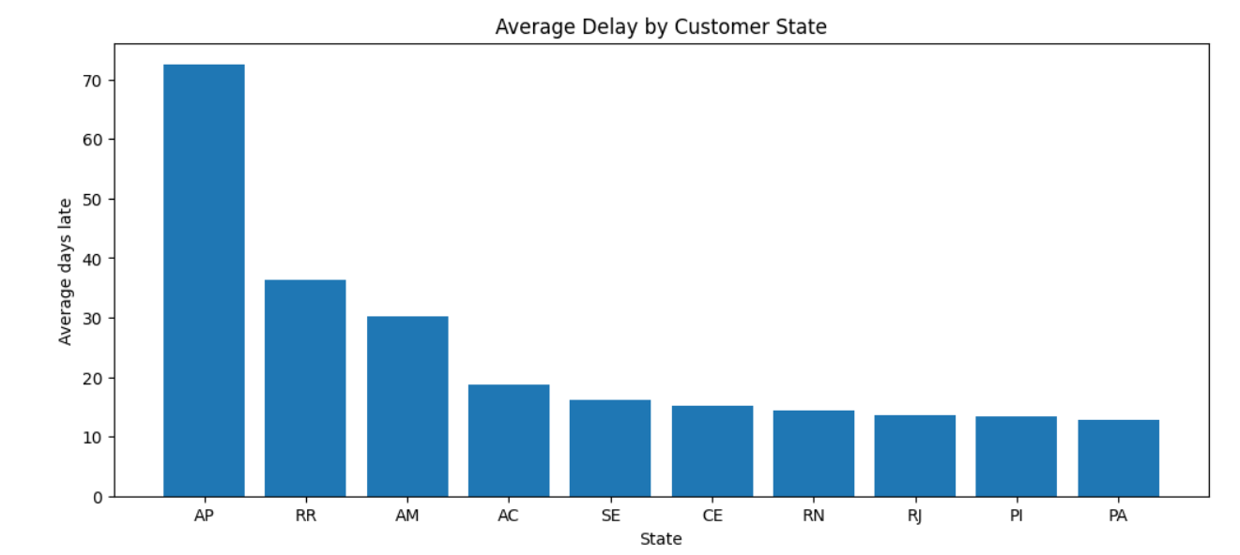
What is the average delay duration, and how does it vary by state?

Slide 10
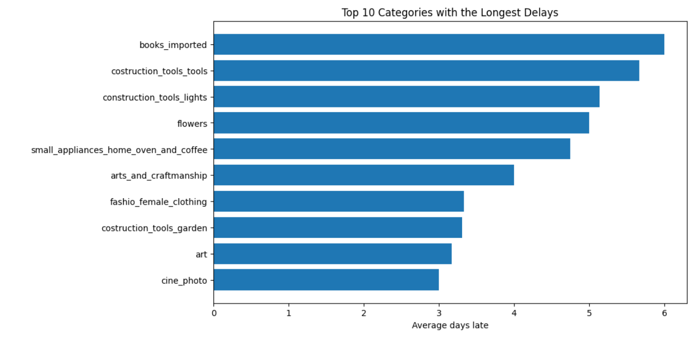
What is the average delay duration, and how does it vary product category?

Slide 11
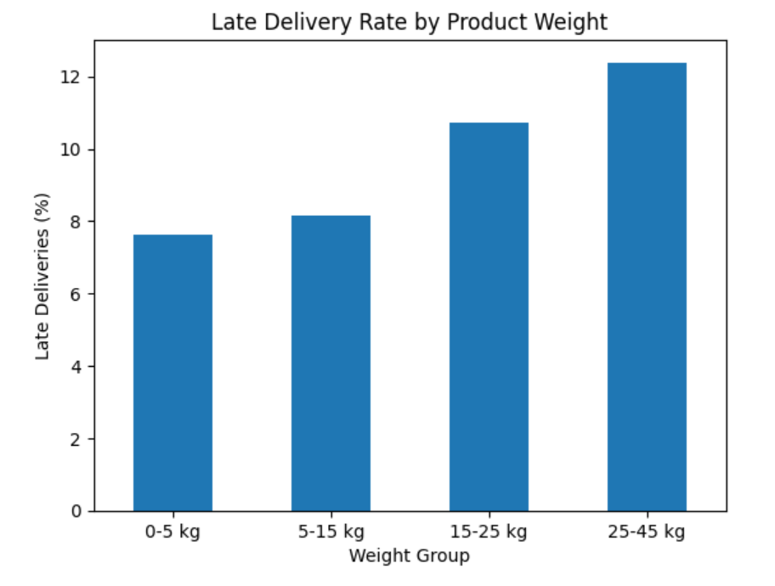
Does order weight or size influence delivery delays?

Slide 12
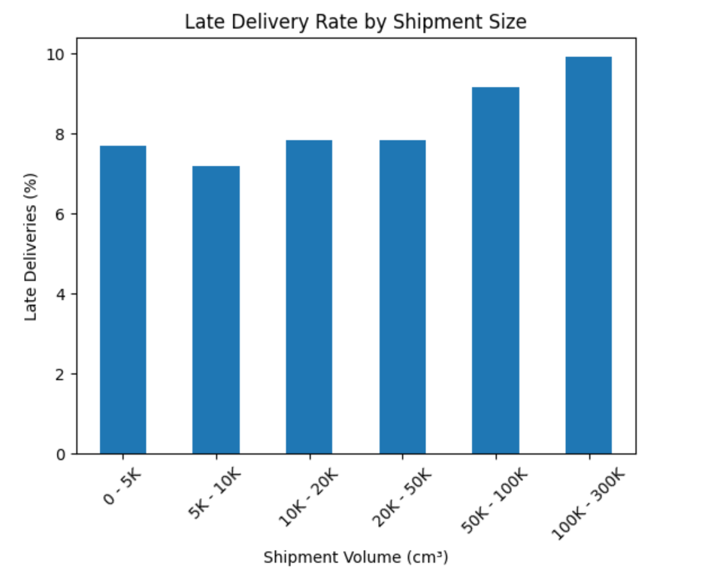
Does order weight or size influence delivery delays?

Slide 13
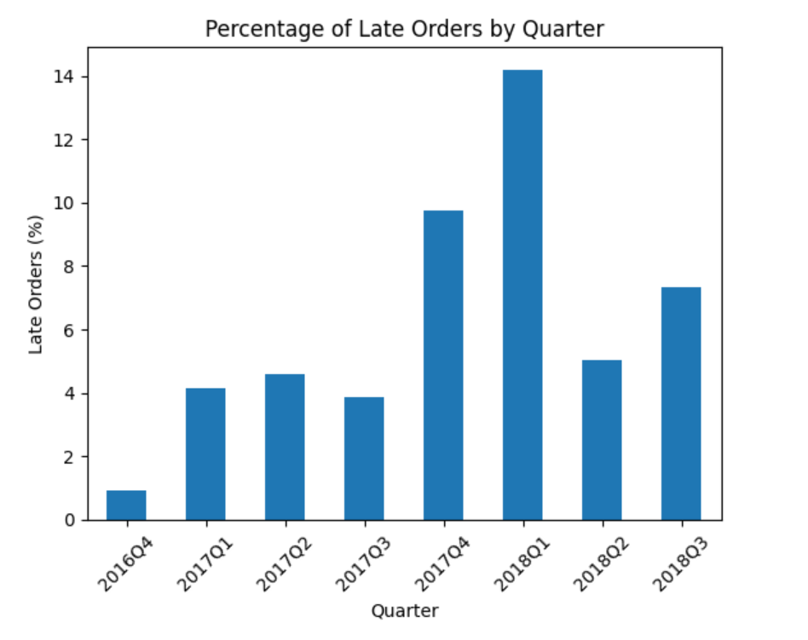
Is the delay pattern consistent (e.g., certain months, weekends, or quarters)?

Slide 14
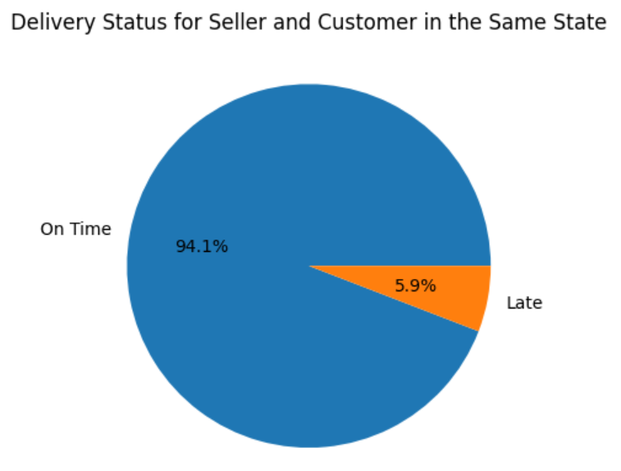
Does lateness occur even when the seller and customer are in the same state?

Slide 15
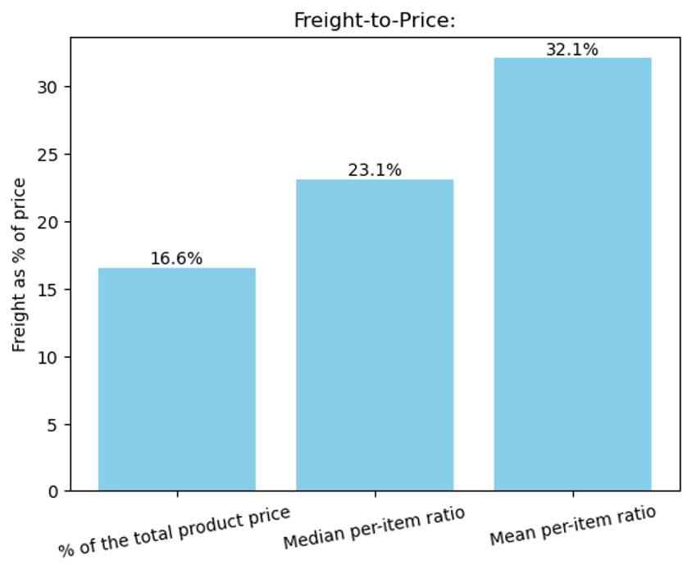
What is the average freight value, and what percentage of the total product price does it represent?

Slide 16
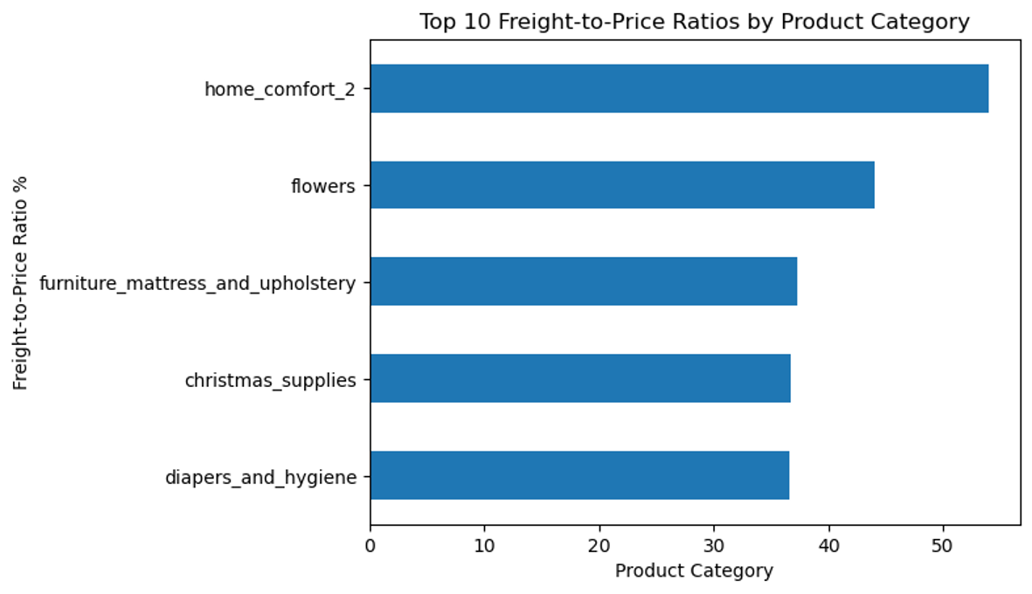
How does the freight-to-price ratio vary by product category or state?

Slide 17
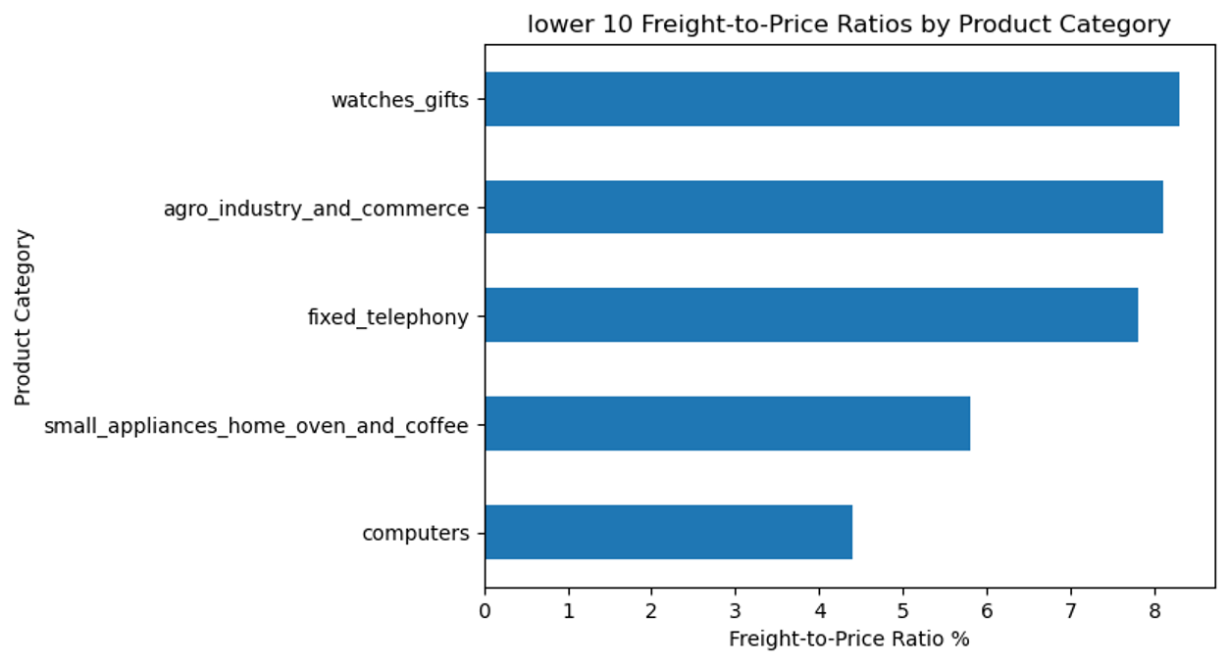
How does the freight-to-price ratio vary by product category or state?

Slide 18
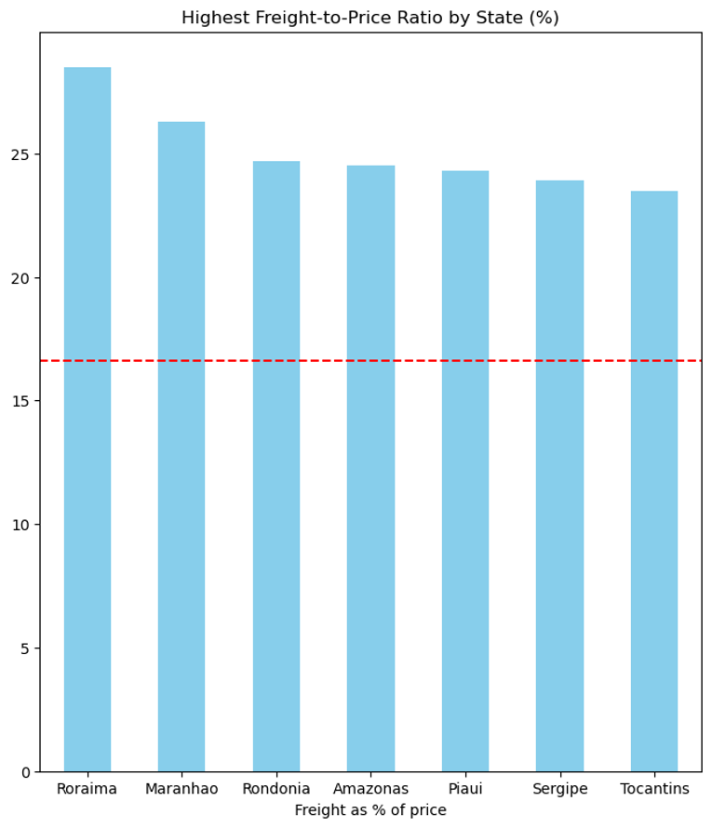

Slide 19
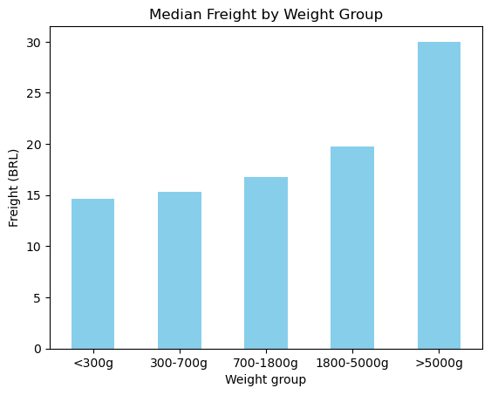
Are lighter products being overcharged (e.g., low weight but high freight)?

Slide 20


Is the shipping partner meeting expectations for on-time delivery and fair pricing?
  On-time delivery is strong, with 93.22% of orders delivered on time.
  Freight pricing is consistent, increasing with product weight and delivery distance.

Slide 21
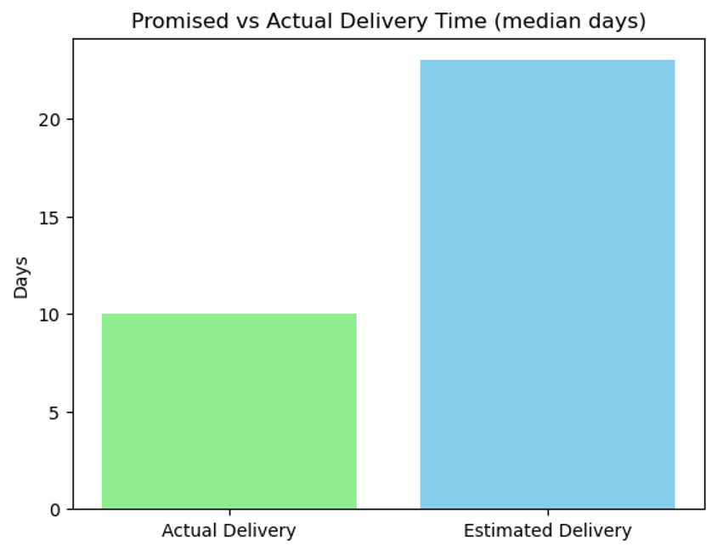
Is the underestimation of delivery time or cost a frequent issue, and why does it occur?

Slide 22
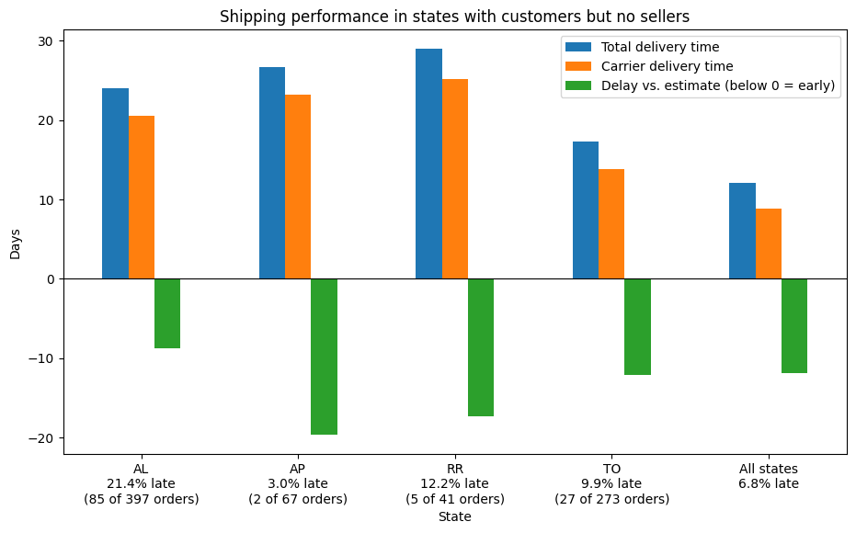
How is the shipping company performing in states with no sellers? Are deliveries to these states delayed or on time?

Slide 23
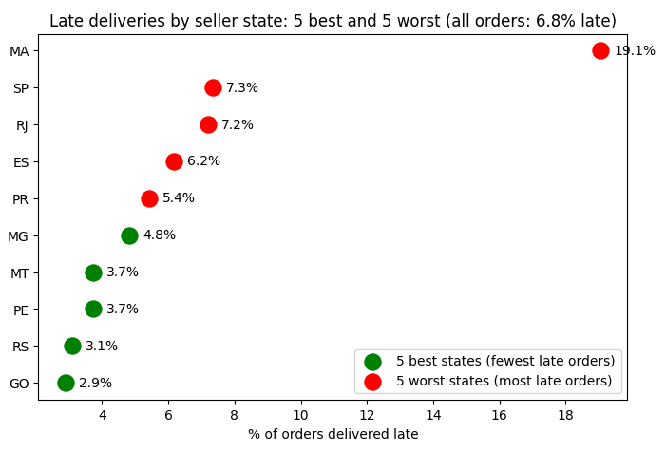
Which states or regions have the highest or lowest delivery performance?

Slide 24
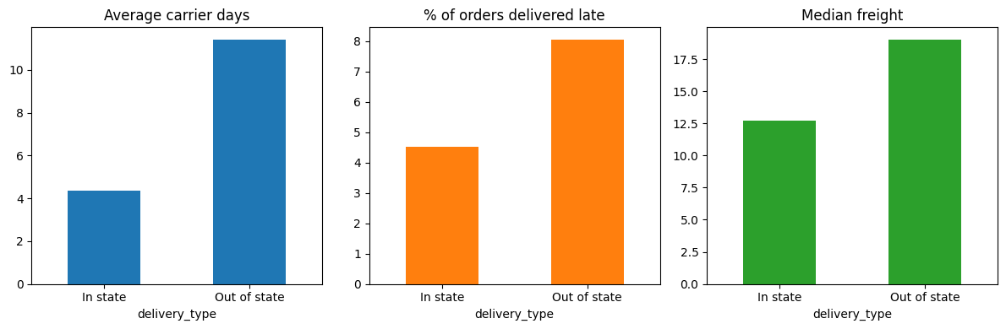
How do in-state vs. out-of-state deliveries compare in terms of timeliness and cost?

Slide 25
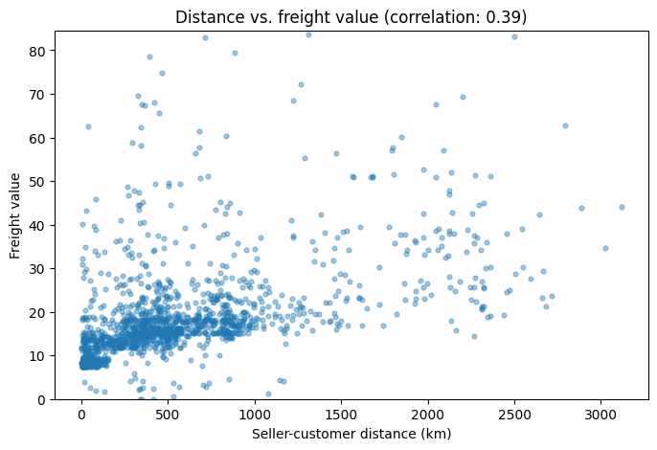
Does seller-customer distance correlate with higher freight ?

Slide 26
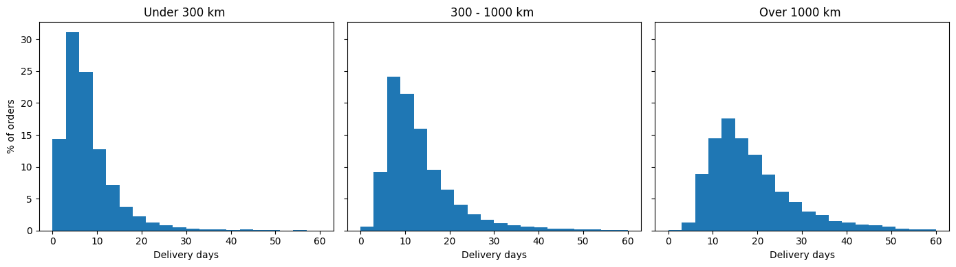
Does seller-customer distance correlate with higher longer delivery times?

Slide 27
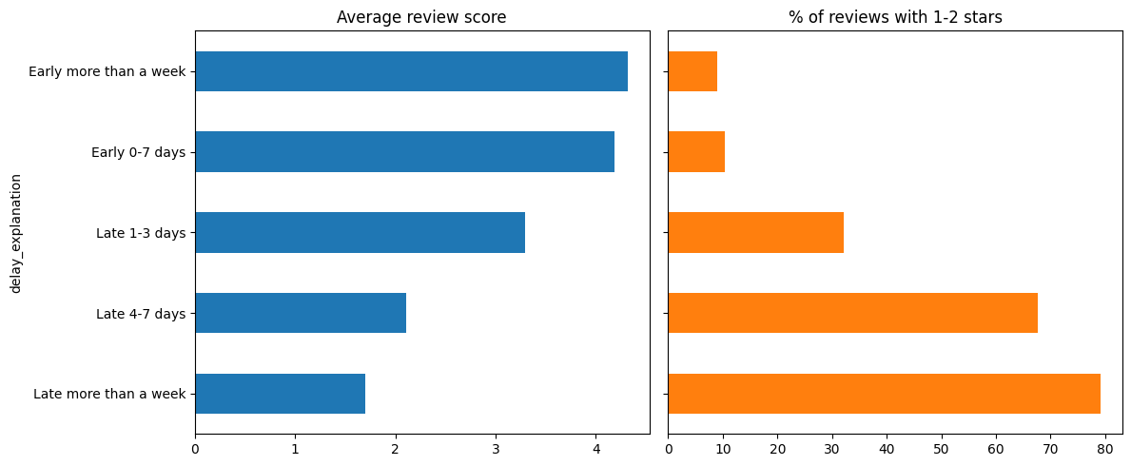
How does delivery performance affect customer satisfaction and reviews?

Slide 28
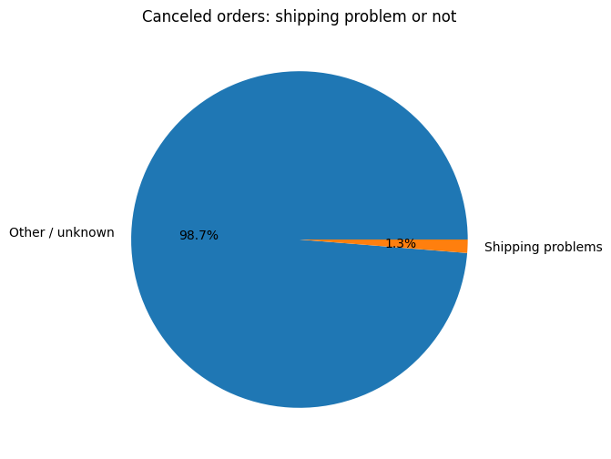
What percentage of order cancellations are due to shipping problems?

Slide 29
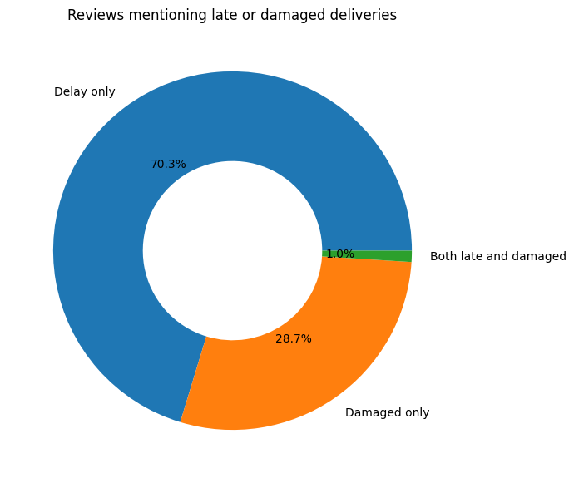
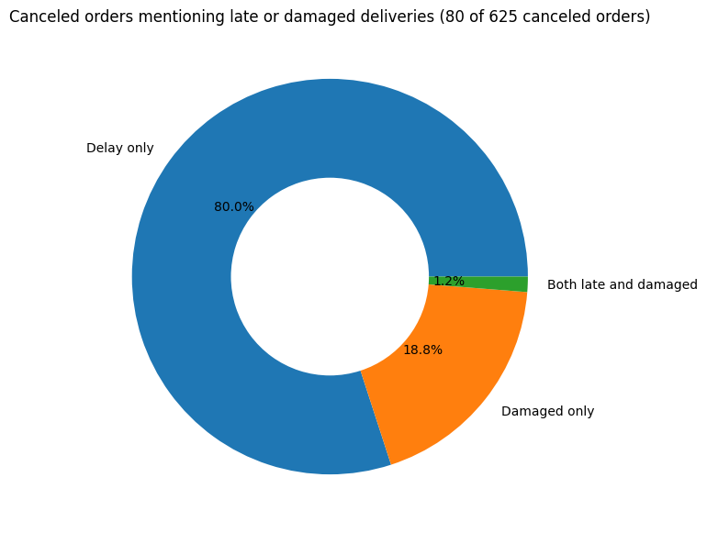
How many cancellations or complaints relate to late or damaged deliveries?

Slide 30
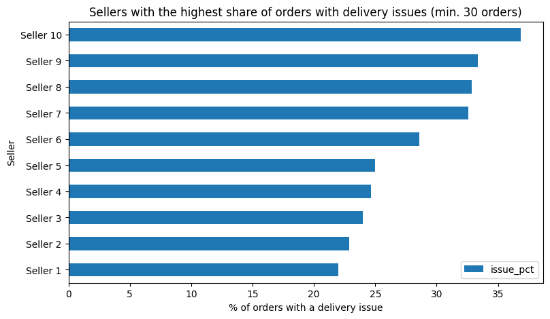
Are there specific sellers with repeated delivery issues (suggesting seller-related problems)?

Slide 31
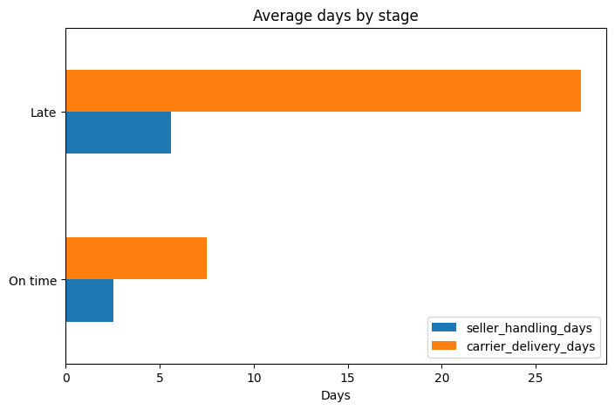
Are delayed items is the shipping or seller responsibility?

Slide 32
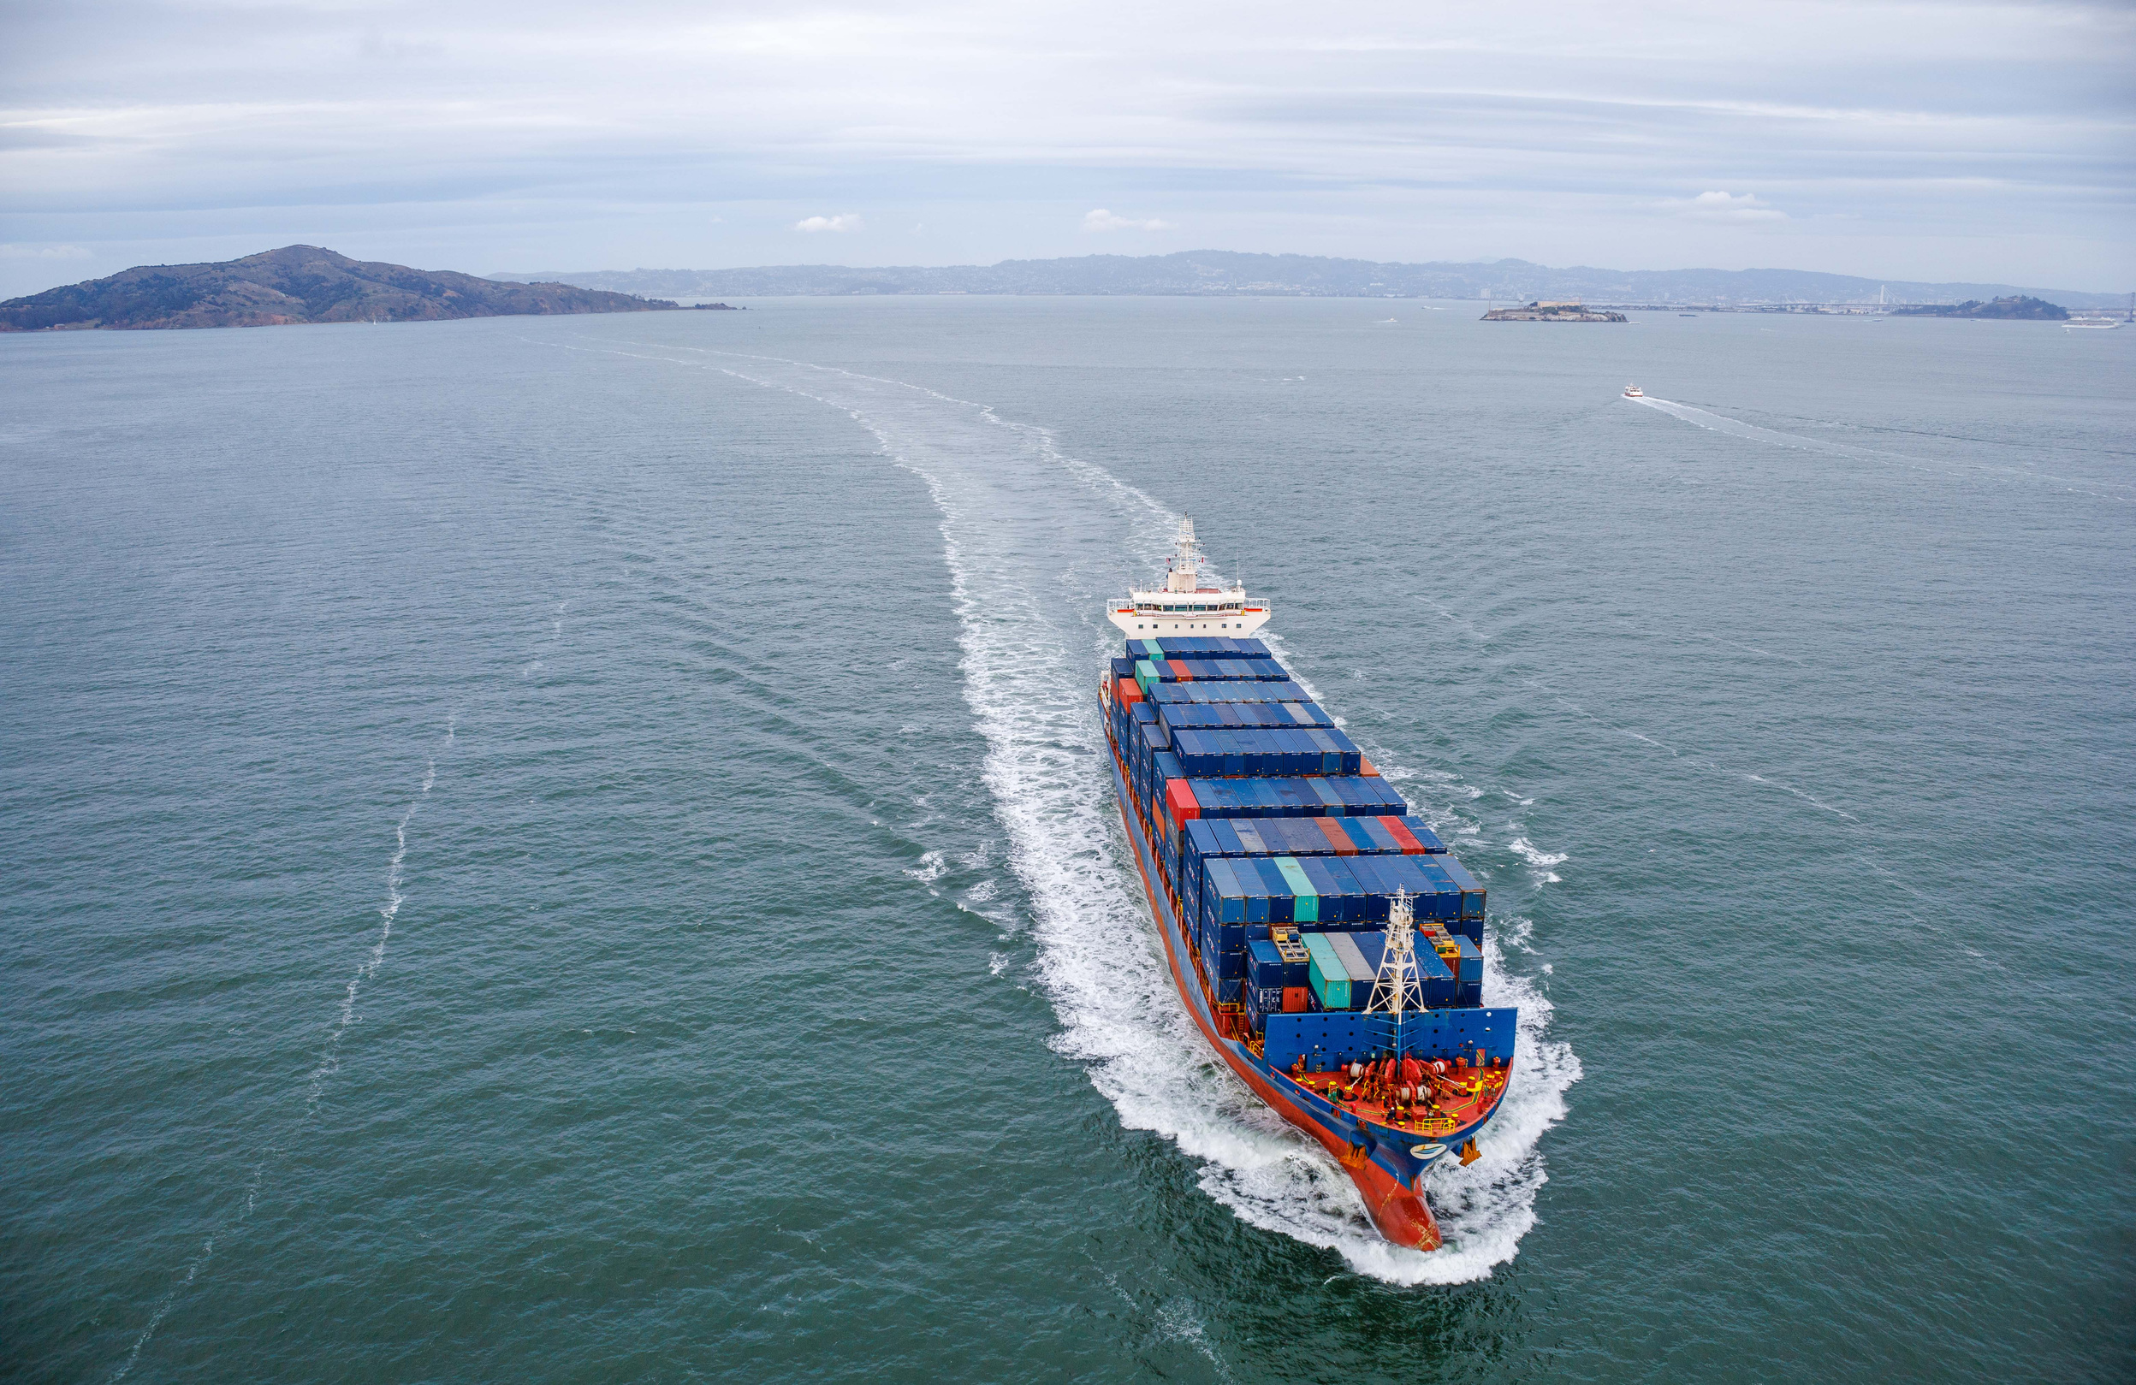

Recommendation
  Continue working with the current shipping partner
  Regularly monitor delivery performance and customer reviews
  ML model to predict whether an order is likely to be on time or delayed

Slide 33


Thank you

